Slide 1
Browser
A browser is an application program that provides a way to look at and interact with all the information on the World Wide Web. This includes Web pages, videos and images. The word "browser" originated prior to the Web as a generic term for user interfaces that let you browse (navigate through and read) text files online. Many people will use web browsers today for access to the internet and is seen almost as a necessity in how many navigate their daily life
A Web browser is a client program that uses HTTP (Hypertext Transfer Protocol) to make requests of Web servers throughout the Internet on behalf of the browser user. Most browsers support e-mail and the File Transfer Protocol (FTP), but a Web browser is not required for those Internet protocols and more specialized client programs are more popular

Slide 2
Web browser history
The first Web browser, called WorldWideWeb, was created in 1990. That browser's name was changed to Nexus to avoid confusion with the developing information space known as the World Wide Web. The first Web browser with a graphical user interface was Mosaic, which appeared in 1993. Many of the user interface features in Mosaic went into Netscape Navigator. Microsoft followed with its Internet Explorer (IE).

Slide 3
How a Web browser works
Web browsers work as part of a client/server model. The client is the browser which runs on the user’s device and makes requests to the Web server, while the server-side is the Web server which sends information back to the browser. The browser then interprets and displays the information on the user’s device.
Web browsers are normally made up of a number of interworking parts. This includes the user interface (UI), which is the level in which the user interacts with the browser. The browser engine is what queries the rendering engine, and the rendering engine is what renders the requested web page—interpreting the HTML or XML documents. Networking is what handles internet security and communication. A JavaScript interpreter is used to interpret and execute JavaScript code in a Website. The UI backend is used to make widgets such as windows. Additionally, a persistence layer, called data persistence or storage, manages data such as bookmarks, caches and cookies.

Slide 4
Popular web browsers
Google Chrome is currently one of the most commonly used browsers. Other browsers include:
Firefox- which was developed by Mozilla.
Microsoft Edge- used a replacement for Internet Explorer, with Windows 10.
Internet explorer- relegated to the past, Microsoft has mostly replaced Internet Explorer with Edge.
Safari- a browser for Apple computers and mobile devices.
Lynx- a text-only browser for UNIX shell and VMS users.
Opera- a fast and stable browser that's compatible with most relatively operating systems.
Flock- an open source browser based on Firefox and optimized for Web 2.0 features such as blogging and Social bookmarking.

Slide 5
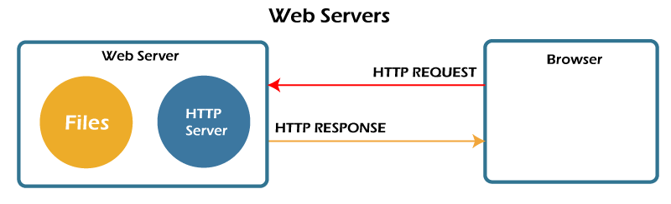
Web Servers
Web pages are a collection of data, including images, text files, hyperlinks, database files etc., all located on some computer (also known as server space) on the Internet. A web server is dedicated software that runs on the server-side. When any user requests their web browser to run any web page, the webserver places all the data materials together into an organized web page and forwards them back to the web browser with the help of the Internet

Slide 6
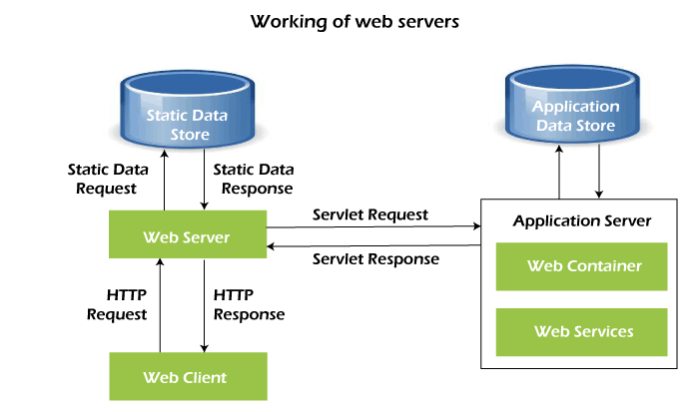
How do web servers work
On the hardware side, a web server is defined as a computer that stores software and another website raw data, such as HTML files, images, text documents, and JavaScript files. The hardware of the web servers are connected to the web and supports the data exchange with different devices connected to the Internet.
On the software side, a web server includes server software accessed through website domain names. It controls how web users access the web files and ensures the supply of website content to the end-user. The web server contains several components, including an HTTP server

Slide 7
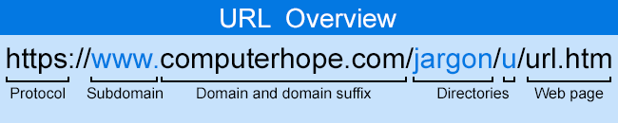
URL (Uniform Resource Locator)
Also known as an internet address or web address, a URL (uniform resource locator) is a URI (uniform resource identifier) and standardized naming convention for addressing documents accessible over the Internet and Intranet. The URL makes it possible for a computer to locate and open a web page on a different computer on the Internet. An example of a URL is https://www.computerhope.com, the URL for the Computer Hope website

Slide 8
Domain name
A domain name is a string of text that maps to an alphanumeric IP address, used to access a website from client software. In plain English, a domain name is the text that a user types into a browser window to reach a particular website. For instance, the domain name for Google is ‘google.com’.
The actual address of a website is a complex numerical IP address (e.g. 192.0.2.2), but thanks to DNS, users are able to enter human-friendly domain names and be routed to the websites they are looking for. This process is known as a DNS lookup.

Slide 9
What is an IP Address
An IP address is a string of numbers separated by periods. IP addresses are expressed as a set of four numbers — an example address might be 192.158.1.38. Each number in the set can range from 0 to 255. So, the full IP addressing range goes from 0.0.0.0 to 255.255.255.255.

Slide 10
What is a packet
In networking, a packet is a small segment of a larger message. Data sent over computer networks*, such as the Internet, is divided into packets. These packets are then recombined by the computer or device that receives them

Slide 11
Why use packets
Theoretically, it could be possible to send files and data over the Internet without chopping them down into small packets of information. One computer could send data to another computer in the form of a long unbroken line of bits (small units of information, communicated as pulses of electricity that computers can interpret).
However, such an approach quickly becomes impractical when more than two computers are involved. While the long line of bits passed over the wires between the two computers, no third computer could use those same wires to send information — it would have to wait its turn
Because of packet switching, packets from multiple computers can travel over the same wires in basically any order. This enables multiple connections to take place over the same networking equipment at the same time. As a result, billions of devices can exchange data on the Internet at the same time, instead of just a handful

